Slide 1

TOUCHLESS
IILM UNIVERSITY, GREATER NOIDA, U.P.
Volume
Control
GESTUREVOLUME:
VOLUME CONTROL WITH HAND GESTURES
Internship Presentation
Student
SHREYA
Enrollment / Roll No.
CS-2341034
Program & Semester
B.Tech CSE (AI/ML) • Semester VII
Section
3CSE3
Webcam • AI Vision
• Real-time Dashboard
Organization
Infosys Springboard
Internship
Internship 7.0 (B1)
Duration
19 June 2026 – 14 August 2026
IILM University • Infosys Springboard Internship 7.0 (B1)

Slide 2
Internship Overview
01
Organization
Internship
Project
Infosys Springboard provided a structured virtual internship environment focused on practical, project-based learning.
Virtual Internship 7.0 (Batch 1), completed from 19 June 2026 to 14 August 2026.
GestureVolume — a real-time computer-vision system for controlling computer volume through hand gestures.
What I worked on
• Applied computer-vision concepts to a real-time user interaction problem.
• Integrated hand landmark detection, gesture measurement, audio control and a browser dashboard.
• Implemented calibration, smoothing, detection controls, FPS monitoring and volume history.
IILM University • Infosys Springboard Internship 7.0 (B1)

Slide 3
Problem Statement
02
The challenge
The proposed solution
Traditional computer-volume control usually requires physical interaction through a keyboard, mouse, touch interface or dedicated hardware.
Use a webcam to detect hand landmarks, measure the thumb–index distance, map it to a volume percentage and provide immediate visual feedback.
Input
Processing
Output
Live webcam frames
Hand landmarks + distance
System volume + dashboard
IILM University • Infosys Springboard Internship 7.0 (B1)

Slide 4
Project Objectives
03
1
Develop a real-time hand-gesture mechanism for system-volume control.
2
Capture and process live webcam frames using OpenCV.
3
Detect hand landmarks using MediaPipe Hands.
4
Map thumb–index distance to a 0–100% volume range.
5
Apply smoothing to reduce unstable frame-to-frame changes.
6
Integrate the vision loop with a Flask-powered dashboard.
7
Provide manual minimum/maximum calibration.
8
Provide detection controls and performance feedback such as FPS.
IILM University • Infosys Springboard Internship 7.0 (B1)

Slide 5
Technologies & Tools
04
Python
OpenCV
MediaPipe
Core application and computer-vision logic
Webcam capture, processing, drawing and frame encoding
Real-time hand landmark detection
Flask
HTML / CSS / JavaScript
Pycaw
Web backend, dashboard and live video/status API
Dashboard structure, styling and client-side interaction
Windows master-volume control through the audio endpoint
Development focus: real-time computer vision + practical human–computer interaction.
IILM University • Infosys Springboard Internship 7.0 (B1)

Slide 6
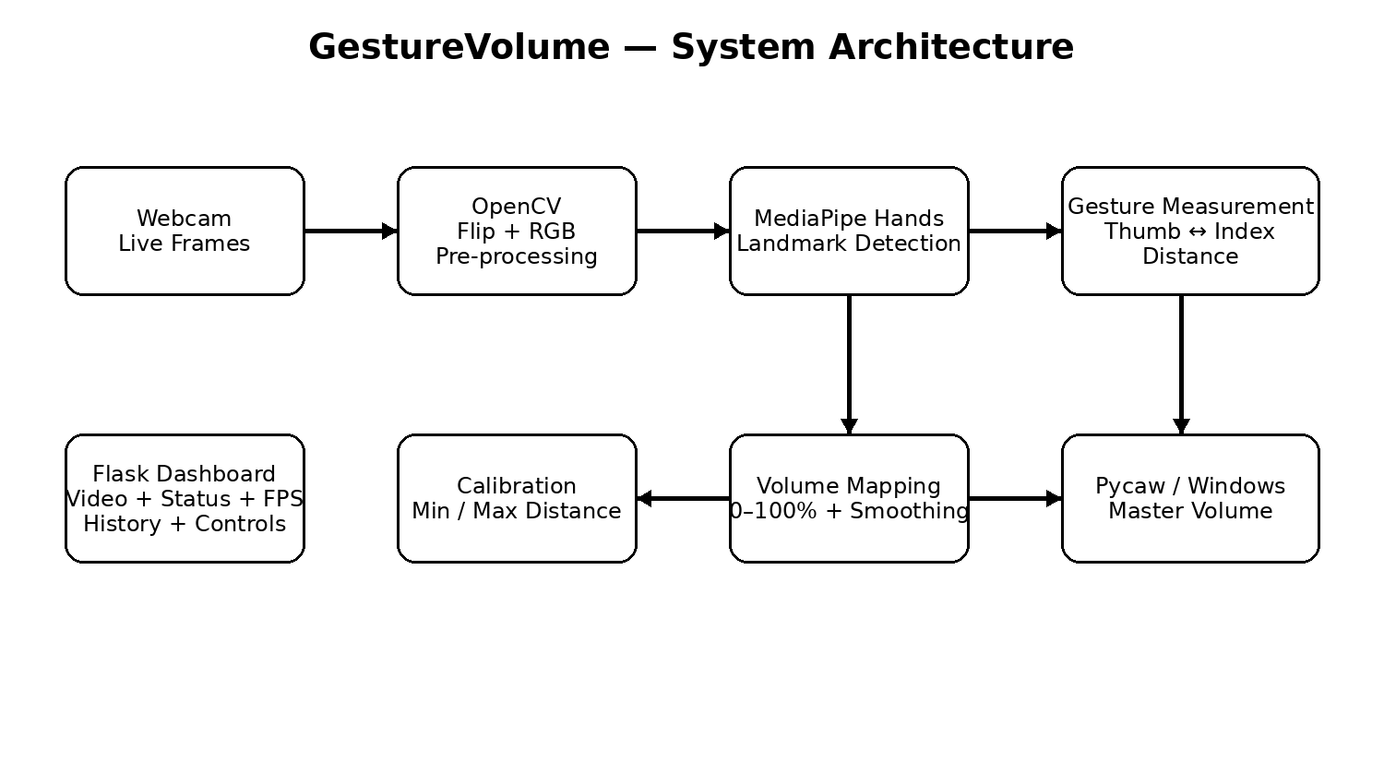
System Architecture
05
IILM University • Infosys Springboard Internship 7.0 (B1)

Slide 7
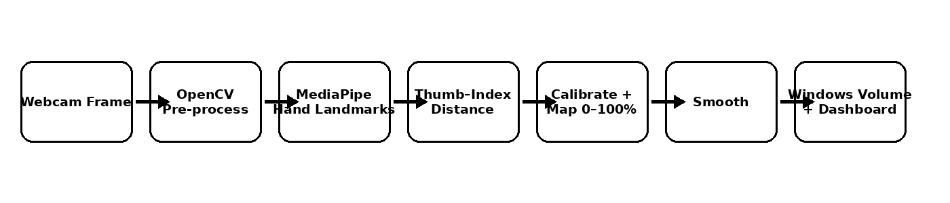
Methodology / Working
06
1
Capture
2
Detect
3
Measure
640 × 480 webcam frames
MediaPipe Hands • one hand
Thumb tip (4) ↔ index tip (8)
4
Map
5
Stabilize
6
Apply
Calibrated distance → 0–100%
Six-sample rolling average
Pycaw updates Windows volume
IILM University • Infosys Springboard Internship 7.0 (B1)

Slide 8
Key Features & Dashboard
07
Real-time gesture control
Manual calibration
Change system volume by varying the distance between thumb and index finger.
Set minimum and maximum observed gesture distances for adaptable control.
Smoothing
Live dashboard
Average recent values to reduce rapid volume fluctuations.
View camera stream, current volume, detection status and FPS.
Volume history
Detection controls
Track volume changes through a client-side history graph.
Enable or pause gesture detection and switch dashboard theme.
IILM University • Infosys Springboard Internship 7.0 (B1)

Slide 9
Outcomes & Learning
08
Project outcomes
Skills strengthened
• Functional real-time webcam-based hand detection.
• Continuous gesture-to-volume conversion.
• Stable volume behavior through short-window averaging.
• Live dashboard feedback with stream, status, volume and FPS.
• Windows system-volume control using Pycaw.
• Calibration and detection controls for usability.
Python programming
Computer vision
MediaPipe hand tracking
Flask web development
Frontend integration
Real-time system design
Debugging & testing
Project documentation
IILM University • Infosys Springboard Internship 7.0 (B1)

Slide 10
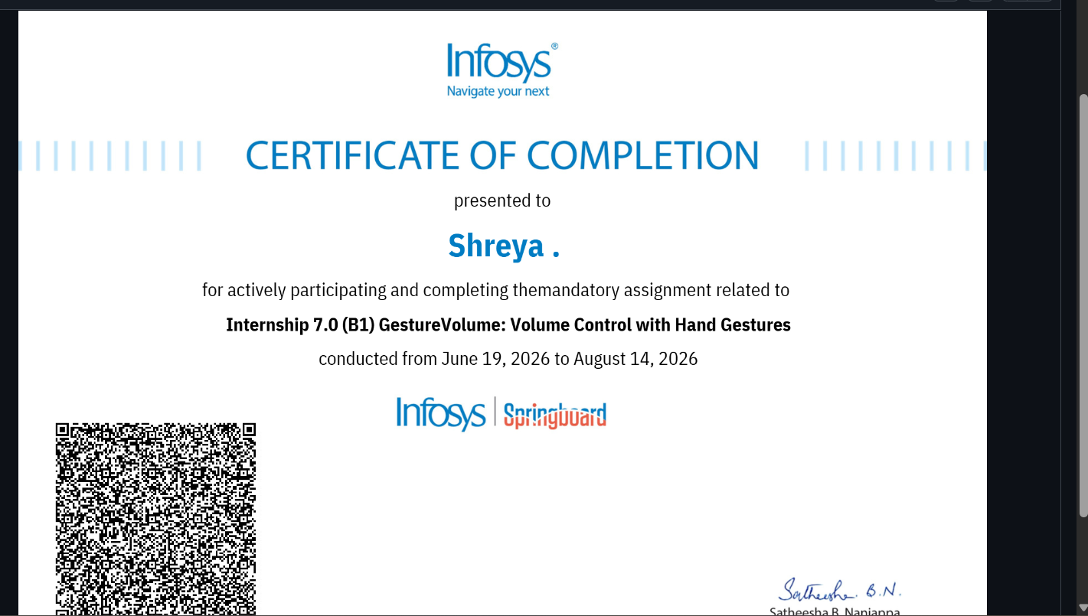
Internship Completion Certificate
09
Infosys Springboard • Internship 7.0 (B1) • 19 June 2026 – 14 August 2026
IILM University • Infosys Springboard Internship 7.0 (B1)

Slide 11
THANK YOU
GestureVolume: Volume Control with Hand Gestures
A practical demonstration of computer vision, real-time processing and touchless human–computer interaction.
SHREYA • CS-2341034 • B.Tech CSE (AI/ML), VII
Infosys Springboard Internship 7.0 (B1)
IILM University • Infosys Springboard Internship 7.0 (B1)

